Slide 1
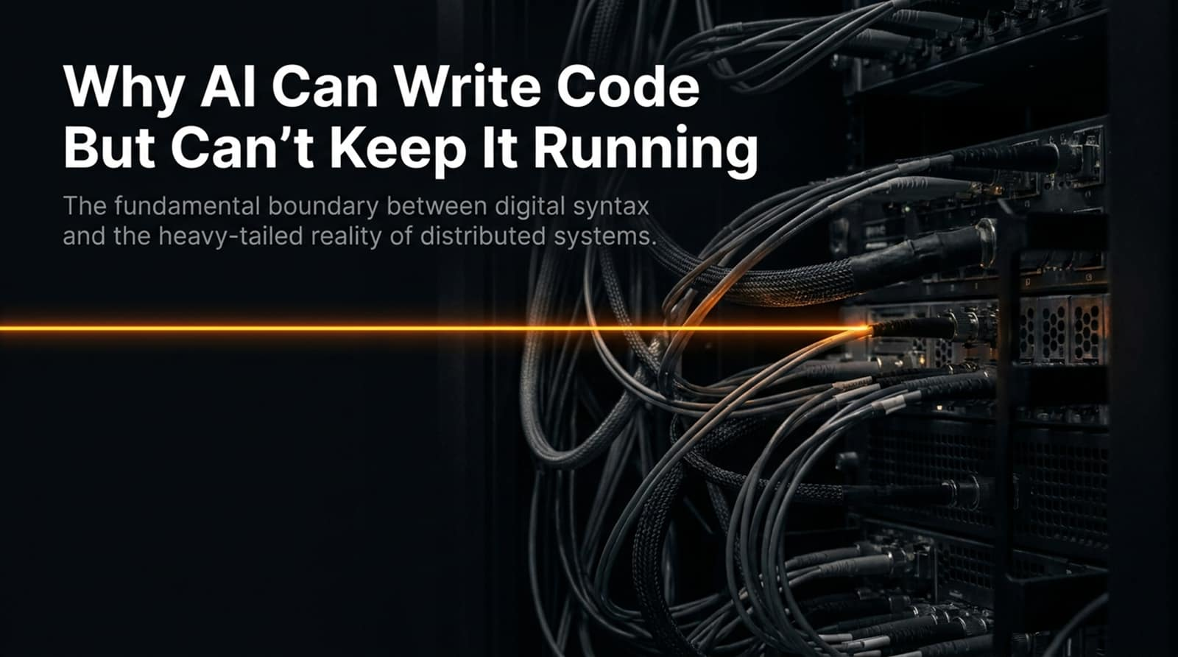
Notes:
Core Topic: Introduction to the AI Runtime Frontier and Distributed Systems Reality
Good morning, everyone, and welcome. Today, we are tackling one of the most pressing architectural questions in modern software engineering: Why AI Can Write Code But Can’t Keep It Running.
If you look at the title subtitle on this slide, it establishes the core boundary: The fundamental boundary between digital syntax and the heavy-tailed reality of distributed systems. Over the last few years, we have watched artificial intelligence achieve miraculous breakthroughs in code generation. Give an LLM a prompt, and it will spit out pristine Python, TypeScript, or SQL in seconds.
But writing code in a sandbox is a completely different universe from keeping complex distributed systems running under live, chaotic production loads. In this slide deck—synthesized from deep technical discussions with systems engineering leaders like Jad Jebrane—we will examine why syntax is solved, why operations remain uncharted, and how engineering teams must adapt to the runtime frontier. Let's jump in.
Why AI Can Write Code But Can’t Keep It Running (Yet)
https://www.youtube.com/watch?v=blkIGLlZePg

Slide 2
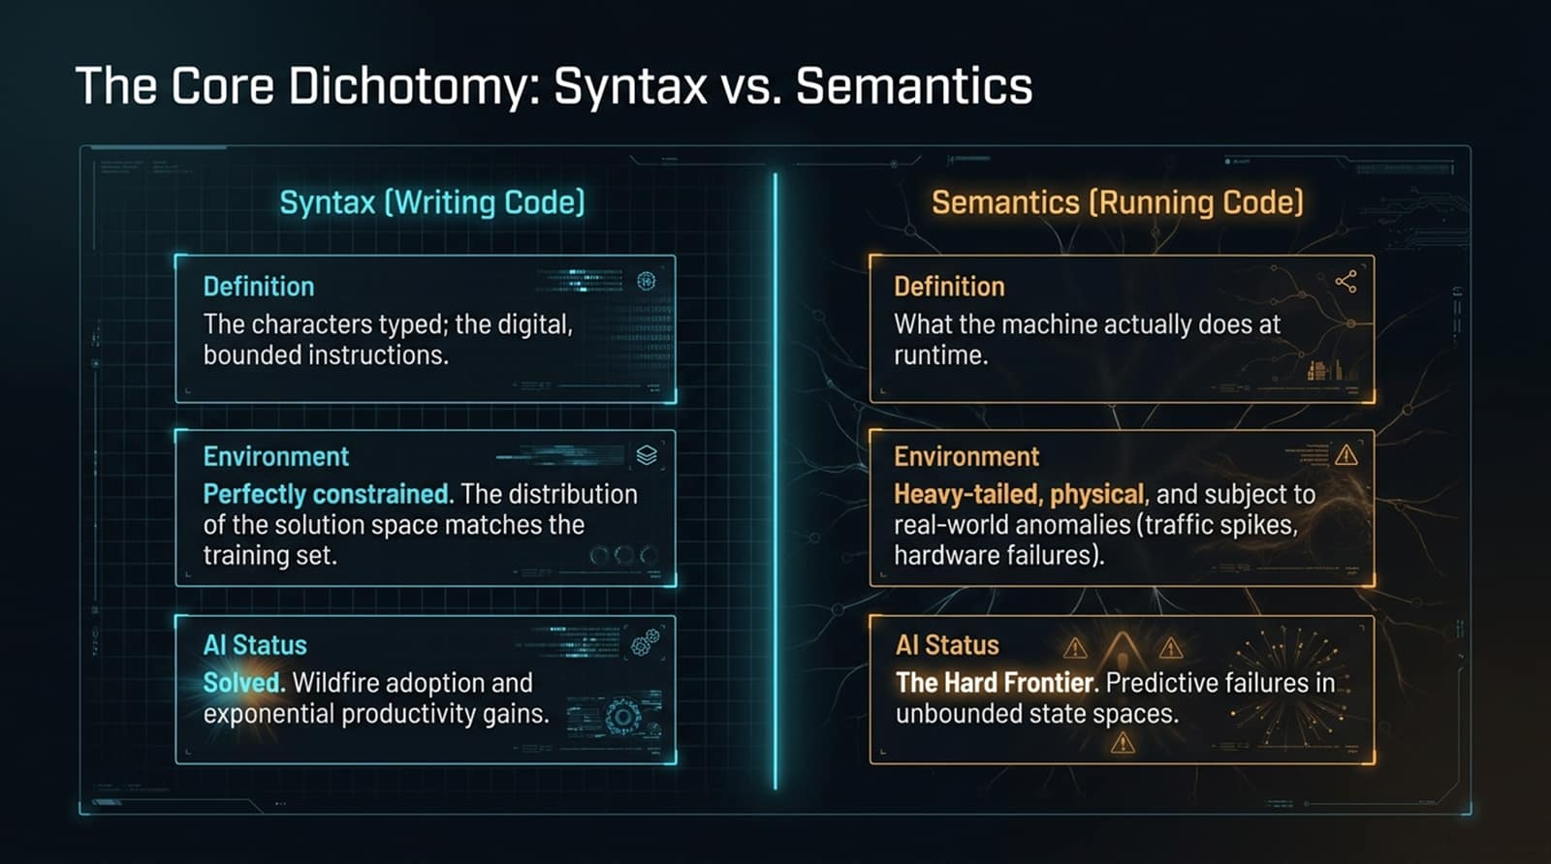
Notes:
Core Topic: Defining the Boundary Between Code Generation and Runtime Execution
To understand the current engineering bottleneck, we must separate two distinct concepts: Syntax and Semantics. Look at the side-by-side comparison on this slide:
Syntax (Writing Code): This is the characters typed—the digital, bounded instructions. The environment is perfectly constrained, and the distribution of the solution space neatly matches the training set of public codebases. AI Status: Solved. We are seeing wildfire adoption and exponential developer productivity gains.
Semantics (Running Code): This is what the machine actually does at runtime. The environment is heavy-tailed, physical, and subject to real-world anomalies like traffic spikes, network partitions, and hardware failures. AI Status: The Hard Frontier. Predicting failures in unbounded state spaces remains an open challenge.
Writing static instructions is easy for a probabilistic model; predicting dynamic system behavior under load is entirely different.

Slide 3
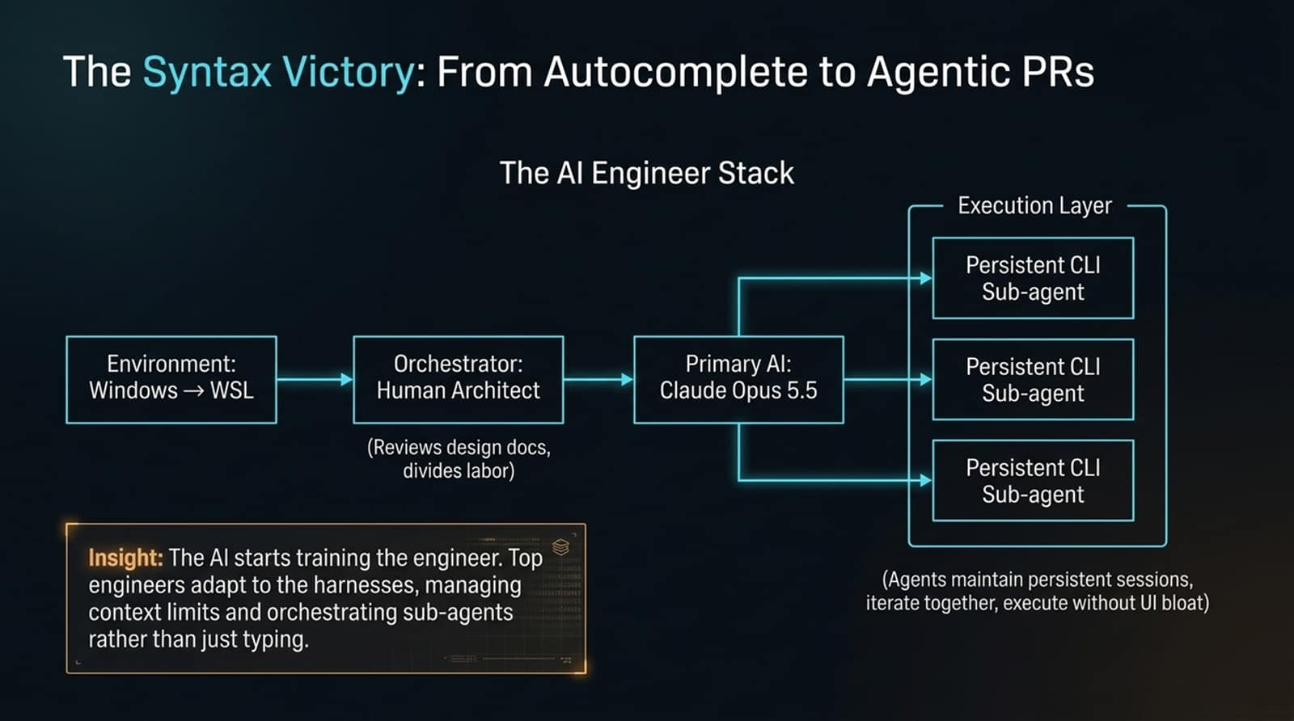
Notes:
Core Topic: Evolution of the AI Engineer Stack and Persistent CLI Sub-Agents
How has the developer's actual workflow evolved over the last few years? Look at The AI Engineer Stack illustrated on this slide:
We start with the developer's environment (e.g., Windows running WSL with Linux tooling).
The Human Architect acts as the orchestrator, reviewing design documents and dividing labor.
The primary AI model (such as Claude Opus) drives the workflow, delegating tasks to Persistent CLI Sub-Agents.
Notice the operational trick: unlike basic chat windows, these sub-agents maintain persistent CLI sessions, iterate together, and execute complex workflows without UI bloat.
The Insight: The AI starts training the engineer. Top engineers adapt to these harnesses, managing context limits and orchestrating autonomous sub-agents rather than just typing lines of code.

Slide 4
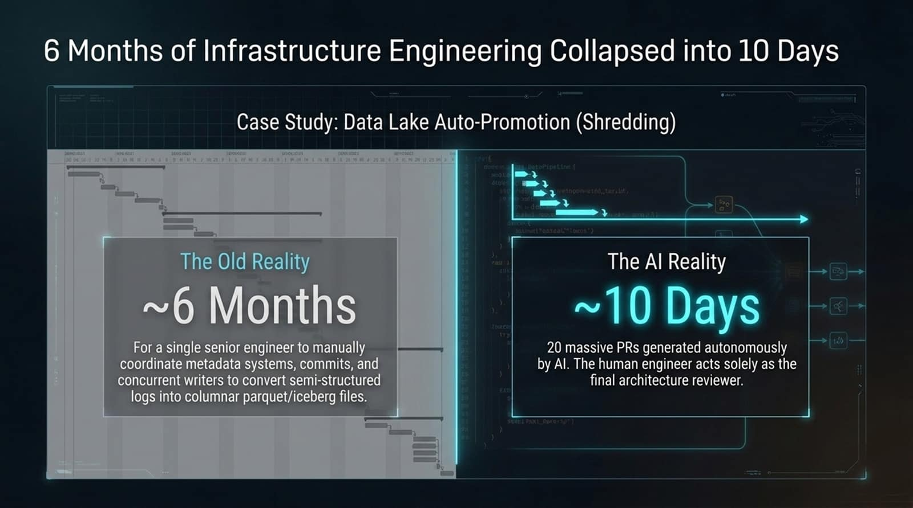
Notes:
Core Topic: Case Study: Autonomous Data Lake Auto-Promotion (Shredding)
To see what this looks like in practice, let's look at a concrete infrastructure case study featured on this slide:
The Old Reality: For a single senior engineer to manually coordinate metadata systems, commits, and concurrent writers to convert semi-structured logs into columnar parquet/iceberg files (data lake shredding) used to take roughly 6 months.
The AI Reality: Using agentic workflows, the same architecture was built and deployed in roughly 10 days.
Over 20 massive Pull Requests were generated autonomously by AI. The human engineer acted solely as the final architecture reviewer. This represents a 10x to 20x velocity multiplier for new infrastructure development.

Slide 5
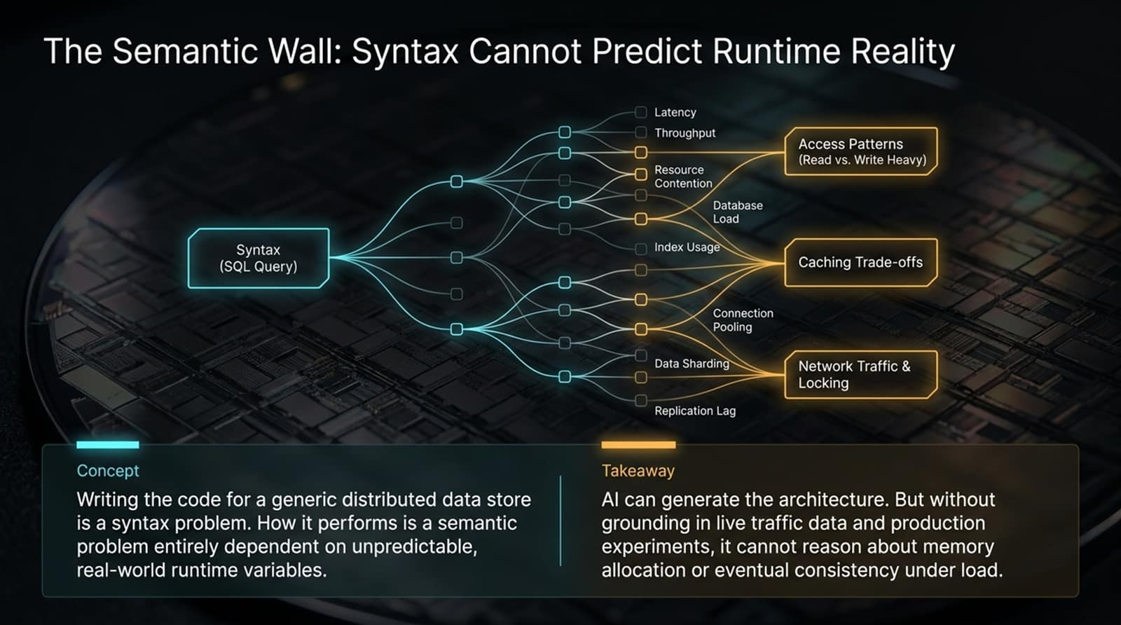
Notes:
Core Topic: Why Generating Code Doesn't Guarantee Production Performance
Even though generating the syntax for a distributed data store is solved, how that code performs at runtime is an entirely different matter.
Look at the decision tree branching out from a simple SQL Query syntax on this slide:
A single query branches into latency, throughput, resource contention, database load, index usage, connection pooling, data sharding, and replication lag.
These branch further into access patterns (read vs. write heavy), caching trade-offs, and network traffic locking.
Takeaway: AI can generate the application architecture and write the queries. But without grounding in live traffic data and production experimentation, it cannot reason about memory allocation or eventual consistency under load. Syntax cannot predict runtime reality.

Slide 6
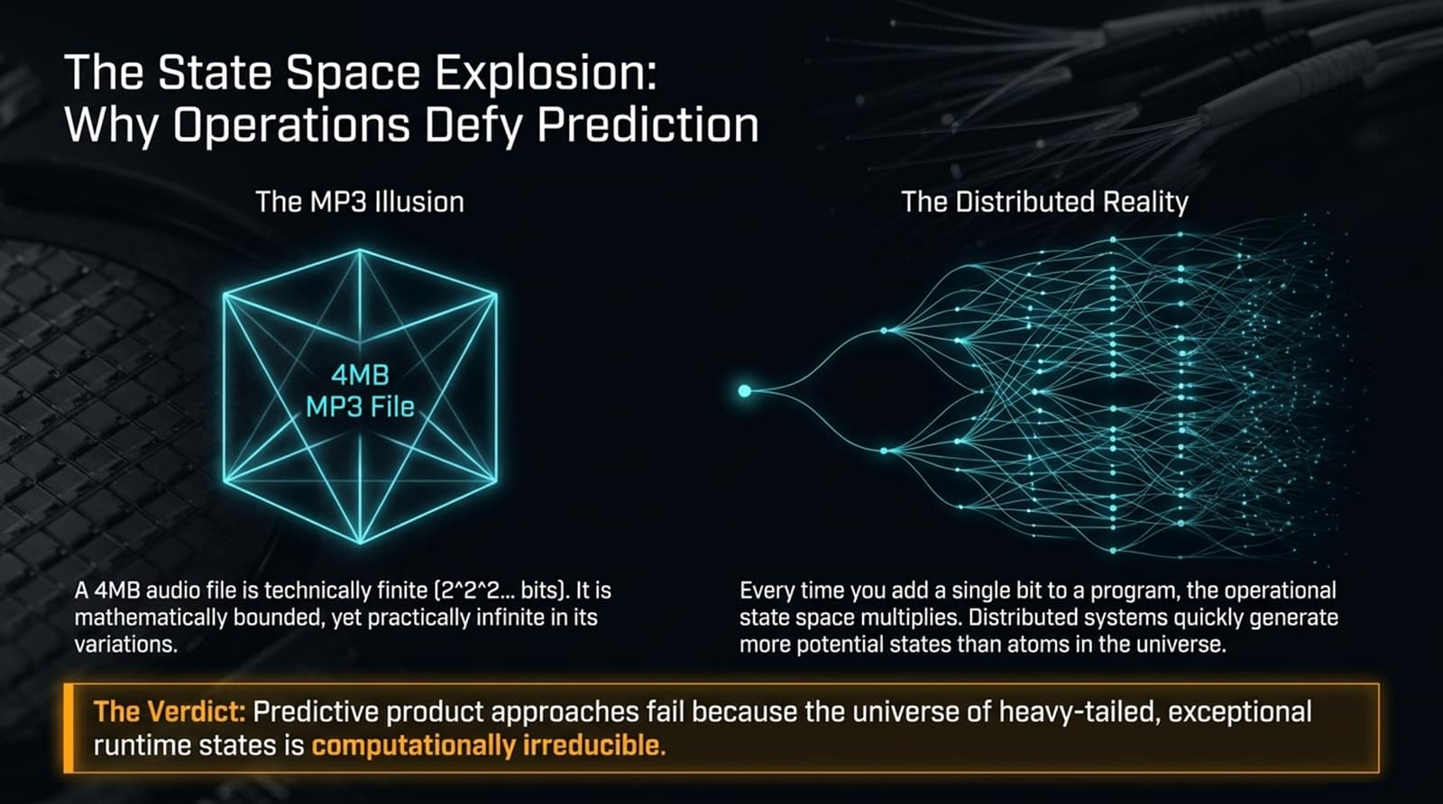
Notes:
Core Topic: Computational Irreducibility and the MP3 Illusion
Why is predictive system operations so mathematically difficult? Consider an analogy shared in systems engineering discussions: The MP3 Illusion.
A 4-byte or 4MB audio file is technically finite ($2^n$ bits). It is mathematically bounded, yet practically infinite in its musical variations.
Now look at The Distributed Reality on the right: Every time you add a single bit or configuration switch to a program, the operational state space multiplies exponentially. Distributed systems quickly generate more potential states than there are atoms in the universe.
The Verdict: Predictive product approaches for distributed systems fail because the universe of heavy-tailed, exceptional runtime states is computationally irreducible.

Slide 7
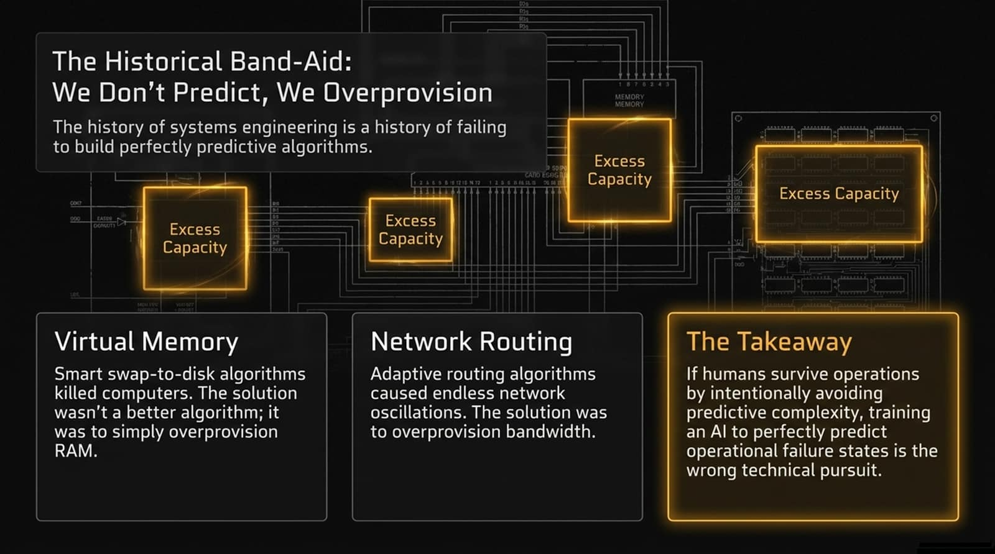
Notes:
Core Topic: Overcoming Impossible Prediction via Hardware Overprovisioning
How has systems engineering historically survived this combinatorial explosion? We don't predict runtime behavior; we overprovision.
Look at the historical examples on this slide:
Virtual Memory: Early smart swap-to-disk algorithms constantly killed computers under memory pressure. The ultimate engineering solution wasn't a smarter algorithm; it was simply to overprovision physical RAM.
Network Routing: Complex adaptive routing algorithms historically caused endless network oscillations and packet storms. The practical solution was to overprovision network bandwidth.
The Takeaway: If human engineers survived operations by intentionally avoiding predictive complexity through overprovisioning, training an AI to perfectly predict operational failure states from scratch is the wrong technical pursuit.

Slide 8
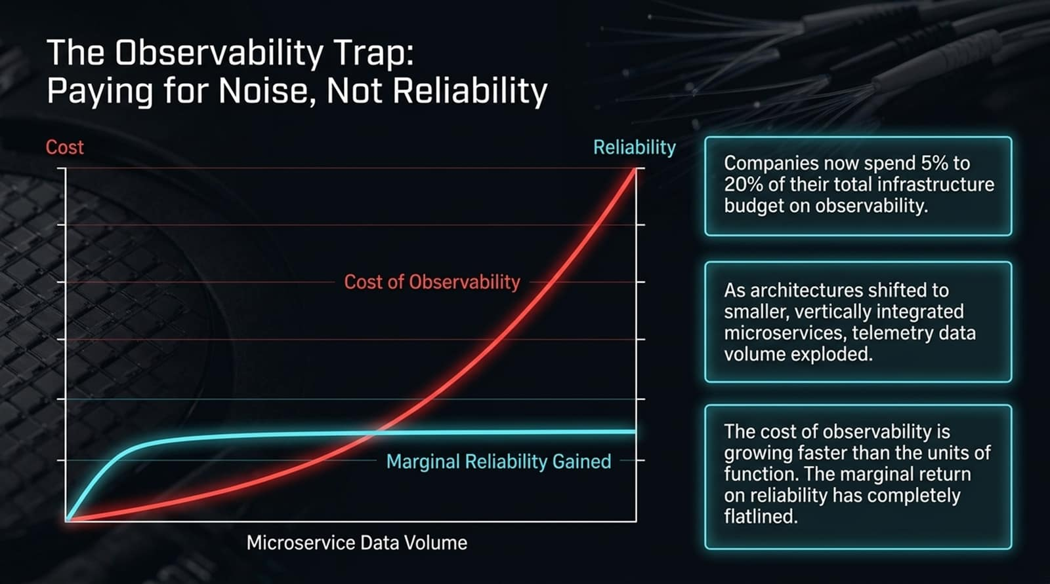
Notes:
Core Topic: Diminishing Returns on Observability Data Volume and Cost
When companies try to gain visibility into these complex systems, they fall into The Observability Trap. Look at the cost vs. reliability chart on this slide:
The Cost Curve: As architectures shifted to smaller, vertically integrated microservices, telemetry data volume exploded exponentially. Companies now spend 5% to 20% of their total infrastructure budget on observability.
The Reliability Curve: While log and metric collection started out helpful, the marginal return on reliability has completely flatlined.
The cost of observability is growing much faster than the units of computing function being outputted. Enterprises are paying massive bills for raw noise, not actual reliability.

Slide 9
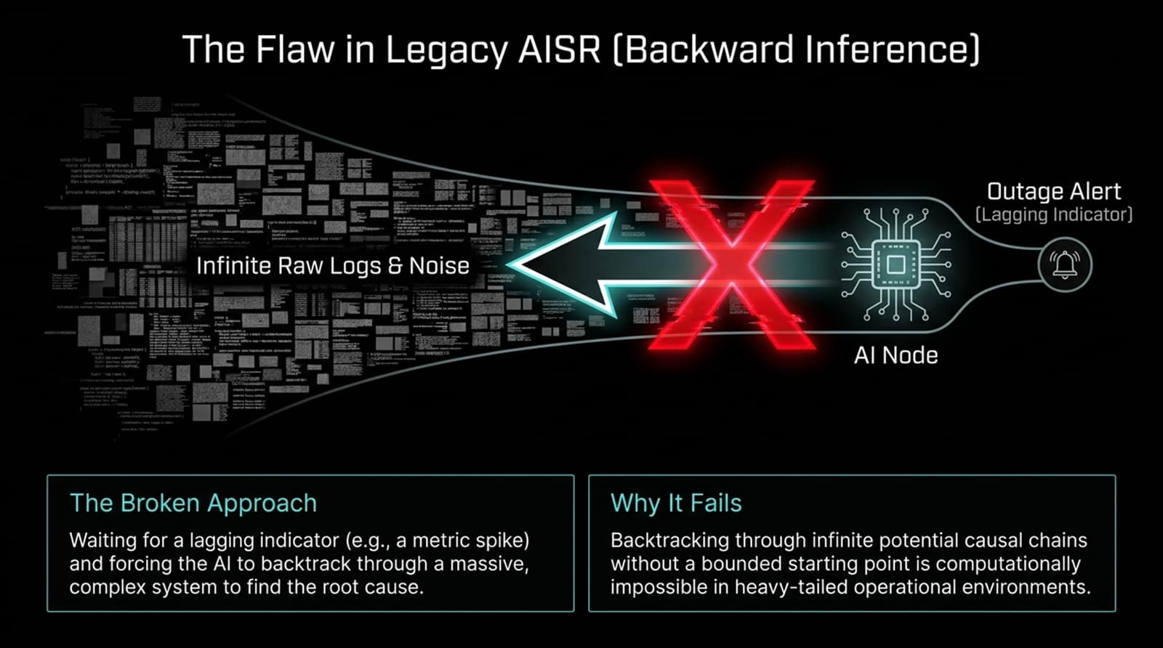
Notes:
Core Topic: Why Reactive Alerting and Backward Log-Backtracking Fail
When teams attempt to apply AI to Site Reliability (AISR), they often build flawed reactive systems. Look at the diagram illustrating Legacy AISR:
An outage alert fires—acting as a lagging indicator.
The AI node is then forced to backtrack backward through petabytes of infinite raw logs and noise to find the root cause.
Why It Fails: Backtracking through infinite potential causal chains without a bounded starting point is computationally impossible in heavy-tailed operational environments. Waiting for a metric spike and telling an AI to search through a haystack of logs is a broken paradigm.

Slide 10
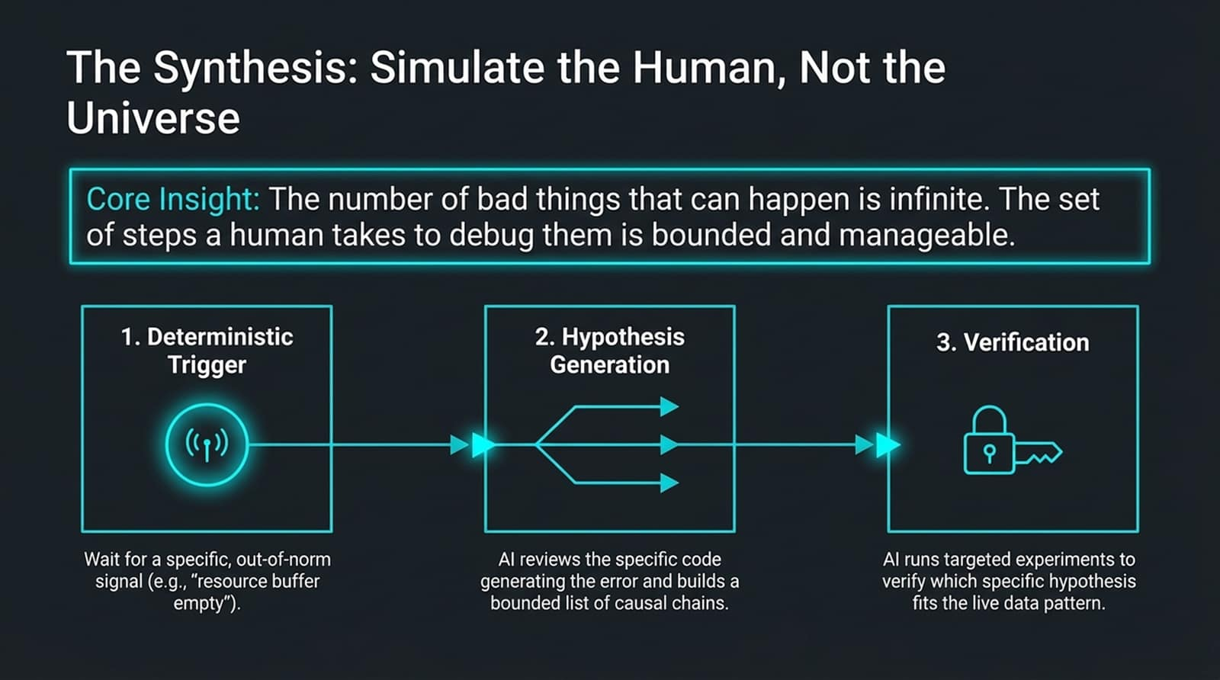
Notes:
Core Topic: Deterministic Triggers, Bounded Hypotheses, and Targeted Verification
If backward inference fails, how should AI be applied to operations? Simulate the human, not the universe.
Core Insight: The number of bad things that can happen in a distributed system is infinite. However, the bounded set of steps a human expert takes to debug them is manageable and structured.
Look at the 3-step operational loop on this slide:
Deterministic Trigger: Wait for a specific, out-of-norm signal (e.g., 'resource buffer empty') rather than chasing lagging alert spikes.
Hypothesis Generation: The AI reviews the specific code generating the error and builds a bounded list of causal chains.
Verification: The AI runs targeted experiments to verify which specific hypothesis fits the live data pattern.

Slide 11
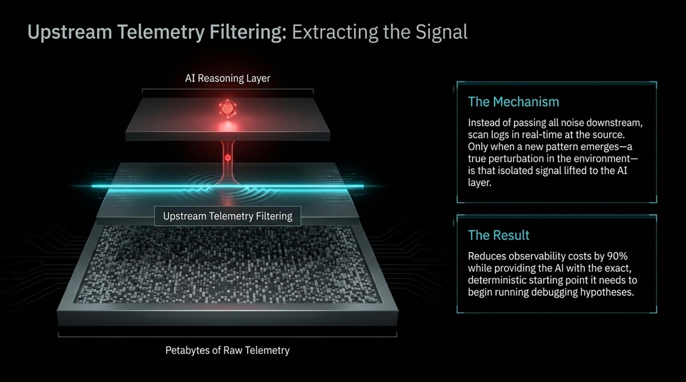
Notes:
Core Topic: Real-Time Upstream Filtering to Reduce Observability Costs by 90%
How do we make this architecture practical at petabyte scale? Through Upstream Telemetry Filtering.
Look at the architectural stack on this slide:
Instead of passing all raw log noise downstream to expensive monitoring platforms, logs are scanned in real-time at the source before leaving the node.
Only when a new pattern emerges—a true perturbation or anomaly in the environment—is that isolated signal lifted to the AI reasoning layer.
The Result: This approach reduces observability costs by up to 90% while providing the AI with the exact, deterministic starting point it needs to begin running debugging hypotheses.

Slide 12
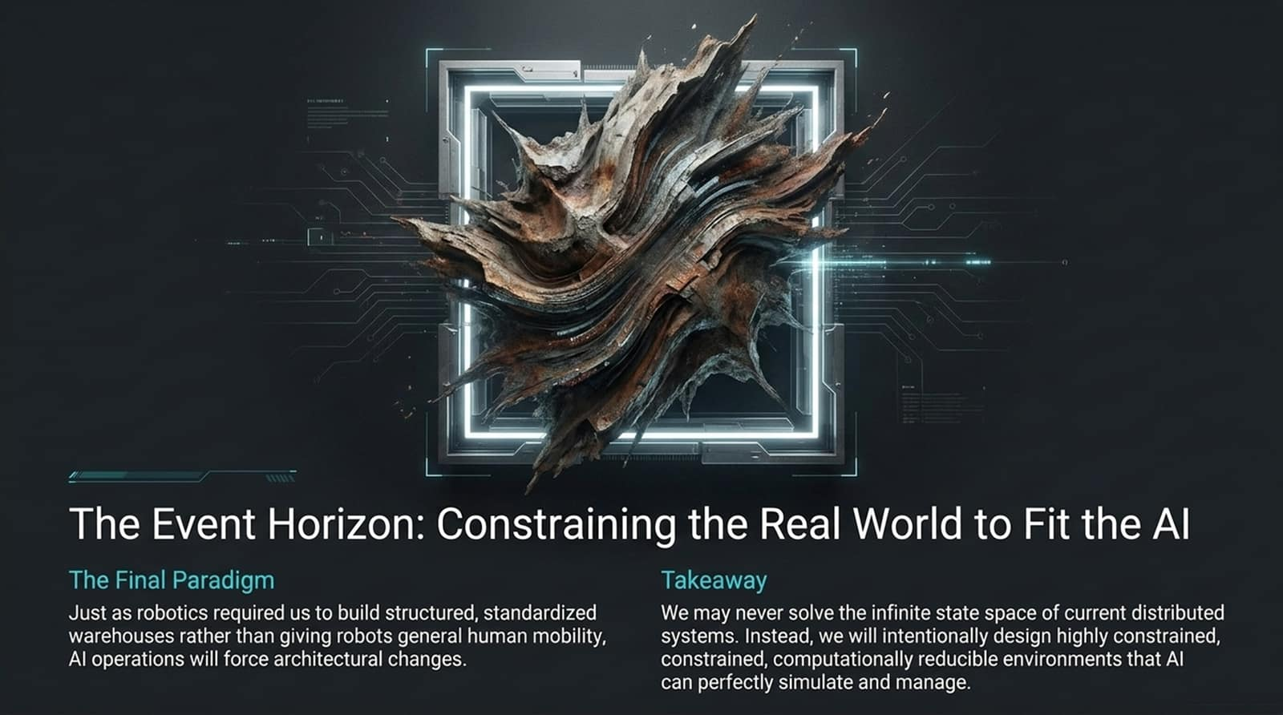
Notes:
Core Topic: Architectural Convergence and Constrained Environments
This brings us to the ultimate strategic realization of the AI era: The Event Horizon.
Think about the history of robotics: Just as physical robotics required us to build structured, standardized warehouses (like Amazon fulfillment centers) rather than giving robots general human mobility across chaotic streets, AI operations will force similar architectural changes.
Takeaway: We may never solve the infinite state space of legacy, unconstrained distributed systems. Instead, we will intentionally design highly constrained, standardized, computationally reducible environments that AI can perfectly simulate and manage.

Slide 13
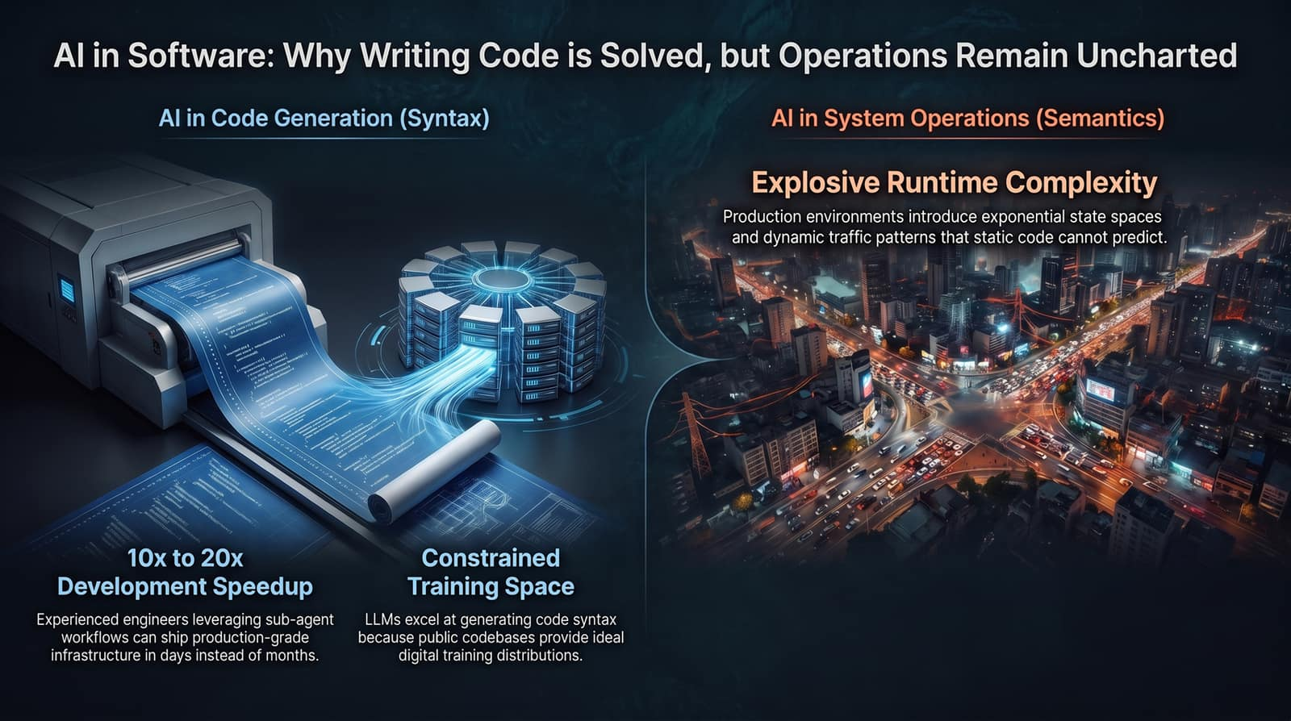
Notes:
Core Topic: Comprehensive Comparison of Code Generation vs. Runtime Operations
Let's summarize the overarching theme of this presentation comparing development and operations:
AI in Code Generation (Syntax): Achieves 10x to 20x developer speedups because public codebases provide ideal digital training distributions within a constrained training space.
AI in System Operations (Semantics): Faces explosive runtime complexity because production environments introduce exponential state spaces and dynamic traffic patterns that static code cannot predict.
Writing code is an intellectual puzzle; keeping systems running is an ongoing battle against entropy.

